Slide 1
COMMUNITY BENEFIT, COMMUNITY BUILDING, AND SUSTAINABILITY: EMERGING OPPORTUNITIES TO WORK WITH HOSPITAL PARTNERS
Vondie Woodbury, Director, Community Benefit
HEALTHY HOUSING WEBINAR
May 29, 2013

Slide 2

WHAT IS COMMUNITY BENEFIT ?
TAX EXEMPT HOSPITALS
2,900 hospitals – Over $12 billion 2002
$24,241,029 CB _ Muskegon projected 2013
Must invest dollars back in return for tax exemption
Reported Annually on 990H
WHAT COUNTS AS COMMUNITY BENEFIT? (IRS)
Programs or activities that address a community need and
meet at least one of the following community benefit objectives:
Improve access to health care services
Enhance the health of the community
Advance medical or health care knowledge
Relieve or reduce a government burden
Best Source to use: CHA Guide for Planning and Reporting Community Benefit

Slide 3
CHANGING PRIORITIES – NEW OPPORTUNITY
TRADITIONAL
Financial Assistance
Clinical Care, Subsidy
Service to Community
Education
Happens: On Hospital Site
NEW EMPHASIS
Behavioral Risk
Population Health
Service with Community
Environmental Change
Happens: In Community
_{Change reflects two factors:}
Federal Law (501(r) and The Business (ACA Changes)
Copyright 2012 Trinity Health - Livonia, Michigan
3

Slide 4
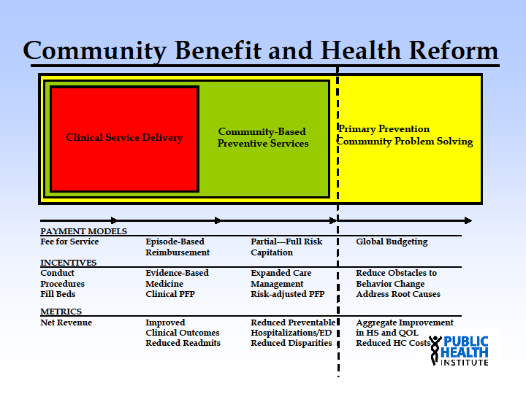
Source: Kevin Barnett, Public Health Institute

Slide 5
THE STEWARDSHIP OPPORTUNITY: BETTER
ASACB* establishes five core principles for nonprofit hospitals to consider.
Principle one is to give priority to those most in need when providing healthcare services.
Principle two calls for addressing the underlying causes of health problems (e.g., asthma) by promoting healthier environments.
Principle three is the building of a seamless continuum of care.
Principle four is to mobilize and work with community groups and business organizations.
Principle five is collaboration with community groups to manage the community benefits program, making them stakeholders in the process.
*ADVANCING THE STATE OF THE ART OF COMMUNITY BENEFIT

Slide 6

HOW ACA DRIVES CHANGE
THE BUSINESS….TARGETS THE COMMUNITY
Fewer Uninsured presumes a shift in CB expenditures Payment model from sick care to keeping people well
Penalties for readmissions
Pressure to target preventable hospitalizations
THE LAW….PUB. L. NO.111-148 (ACA)
Community Health Needs Assessment
Implementation Plans
Transparency
Engagement of Public Health

Slide 7
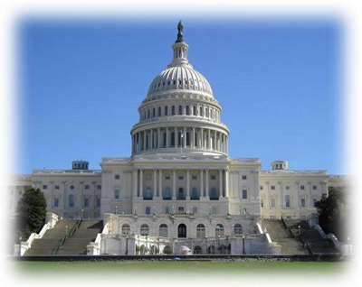
SCHEDULE H AND THE 990 – ASSESSING NEED
Schedule H – Reporting Framework for CB
Details information about charitable practice of hospital
Links with CHNA and Implementation Plan
Conduct Assessments every three years
Assessment and Implementation in same tax year
Attach to the 990
Input from broad interest of community
Have public health knowledge and expertise
Collaborate with others
Publish on web & other sources
CHECK IT OUT:
Schedule H Form: 2012 IRS 990 H
www.irs.gov/pub/irs-prior/f990sh--2012.pdf
Schedule H Instructions:
www.irs.gov/pub/irs-prior/i990sh--2012.pdf

Slide 8
YOUR FOCUS: COMMUNITY BUILDING ACTIVITIES
Traditional IRS Definition: Activities to protect or improve the community’s health or safety and that are not reportable as community benefit.
The Instructions said…
2010: “Report in this part…activities…to protect health or safety, and that are not reportable in Part I or III
2011: “Some Community Building activities may also meet the definition of community benefit.”
These activities are reported under Part I 7(e) as Community Health Improvement Services.

Slide 9

COMMUNITY BUILDING SUBCATEGORIES
Programs that, while not directly related to health care, provide opportunities to address the root causes of health problems such as poverty, homelessness, and environmental problems..
Physical Improvements and Housing
Economic Development
Community Support
Environmental improvements
Leadership Development and training for community members
Coalition Building
Community health improvement /advocacy
Workforce development
Other community building activities or programs

Slide 10
COMMUNITY HEALTH IMPROVEMENT CATEGORIES
Community Health Education, including classes and education campaigns, support groups and self-help groups.
Community-based clinical services, such as screening, provided on a one-time basis or special event in the community
Health care support services, such as enrollment into Medicaid, to increase access and quality of care to individuals, especially the vulnerable
Social and environmental improvement activities, such as removing lead from public housing, that address the determinants of health including social, economic and physical environment.

Slide 11
OPPORTUNITIES FOR HOUSING ADVOCATES
ENGAGE in your local Needs Assessment and Implementation Plan process – remember the CHNA findings prioritize where a hospital spends.
REACH OUT to your hospital community benefit leader. Introduce them to your program. Articulate how your program addresses the local Needs Assessment. (990 H)
INVESTIGATE “Socially Responsible Investing” – Many hospitals are already actively engaged in Community Development
LEARN what other hospitals are doing in community building
Bay Area Healthy Communities engaging Federal Reserve
Health Systems Learning Group – White House Office of Faith Based & Community Partnership
OTHER TOOLS and national efforts to watch:
The Hilltop Institute – White Paper on Community Building/Public Health
“Collective Impact” Model
CHNA.org

Slide 12

DEVELOPMENT OF COMMUNITY BUILDING TOOLS
NEW ITEMS WORTH CHECKING OUT FROM CHA…
Population Health – The New Normal - Health Progress – January/February 2013
Healing Communities – April 2013 - Draft

Slide 13

YOUR CHALLENGES
The capacity of local hospital CB leadership to engage
Willingness of hospital to move out of “comfort zone”
Anxiety about the impact of the ACA
Enrollment
Payment shift
Old traditions die hard – “checking off the box”
Adjusting local CB activities can be “political”
Understanding geography – “where do I invest?”
How well local folks at the hospital understand that housing investment is reportable.

Slide 14
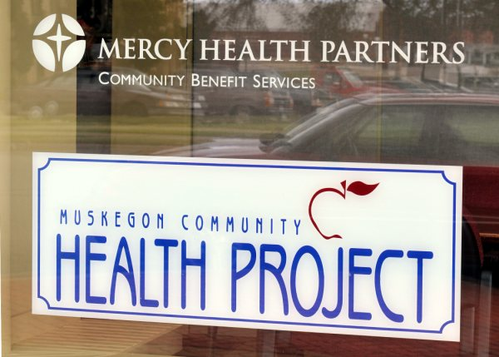
QUESTIONS?
Contact: Vondie Woodbury
Director, Community Benefit – Trinity Health
woodburv@mchp.org
231-672-3201
www.mchp.org

